Slide 1
Predicting Arrhythmia Using Cardiac History
Medhini Oak (1BM16CS047)
Aditi Awasthi (1BM16CS008)
Deepthi Bhat (1BM16CS003)
Under the guidance of Mrs. K. Panimozhi
Assistant Professor, CSE Department

Slide 2
Aim of the Project
The project aims at computer assisted analysis of historical ECG data and classification of the arrhythmia class of a given subject based on the analysis and can thus, play a huge role as a decision support system to the doctors. It tackles this goal in the form of a supervised learning problem.

Slide 3
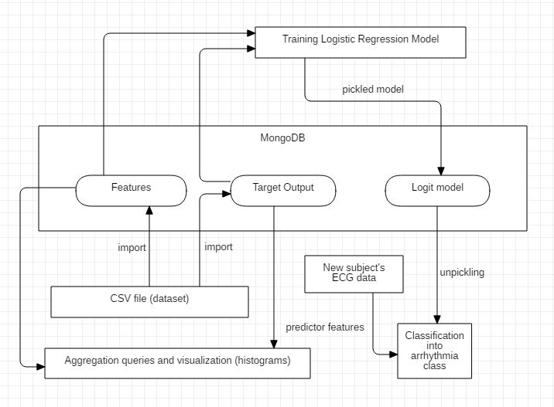
Project Design Diagram

Slide 4
List of Queries Executed
db.features.insert({"_id":0,"0":76.0,"1":1.0,...,"174":49.0});
db.model.find({"name":"logit"});
db.target_output.find({"class":"4"});
db.features.aggregate({$match : { "_id" : { $in : ["0","32","65","126","432"] }}},{ $group : { "_id" : {}, "minPrice" : { $min : $0 }}});
db.features.aggregate({$match : { "_id" : { $in : ["0","32","65","126","432"] }}},{ $group : { "_id" : {}, "maxPrice" : { $max : $3 }}});
db.features.aggregate({$match : { "_id" : { $in : ["0","32","65","126","432"] }}},{ $group : { "_id" : {}, "avgPrice" : { $avg : $13 }}});
db.features.find({"_id" : { $in : ["0","32","65","126","432"] }},{"3" : 1 });

Slide 5
Results
The model is trained with an accuracy of 99.6% and is accurately able to classify a subject’s ECG data. The technique illustrated in our project can be deployed in hospitals where a large dataset is available and can help doctors in making more precise decisions and to cut down the number of casualties due to heart diseases in the future.

Slide 6
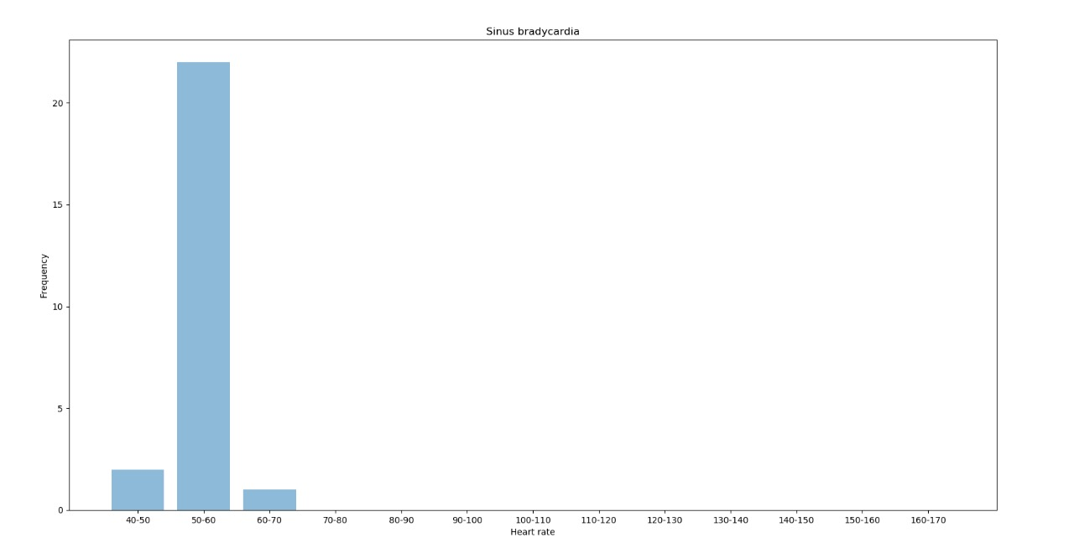
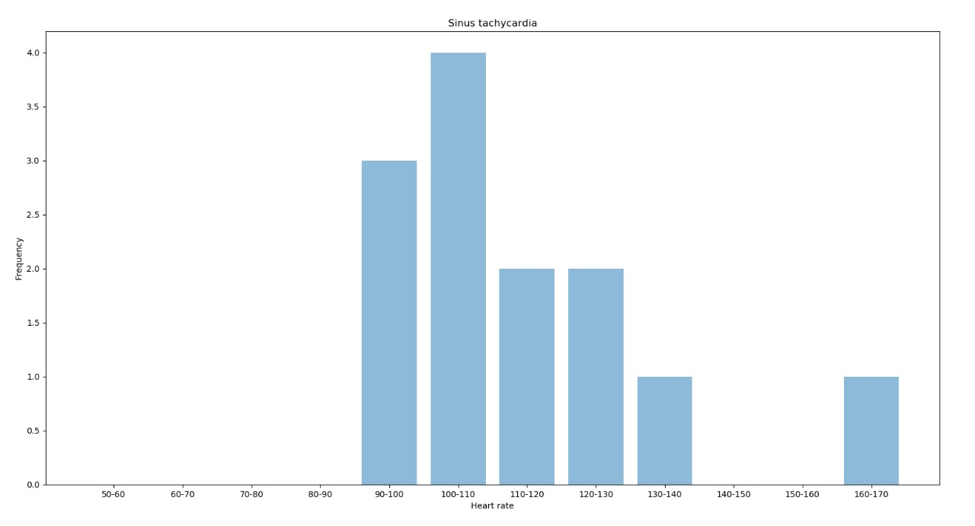
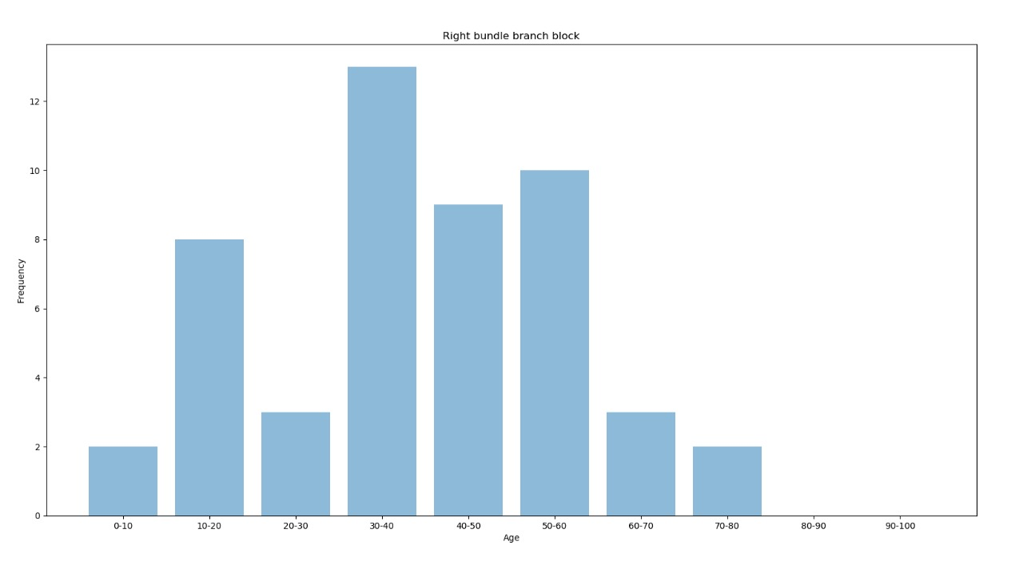
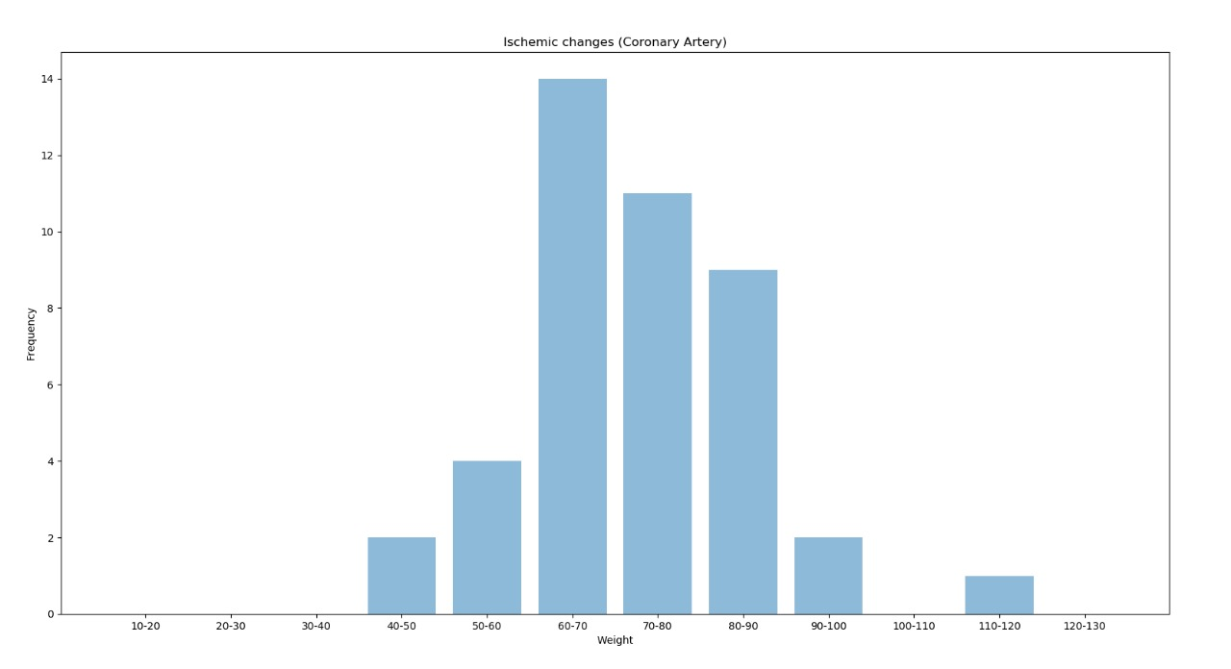
Graphs
Example Frequency graphs for occurrence of a given class of Arrythmia against features like age, weight and heart rate.

Slide 7
Thank You

